Slide 1
The Client-Server Model – part 1

Slide 2
Introduction
The Client-Server paradigm is the most prevalent model for distributed computing protocols.
It is the basis of all distributed computing paradigms at a higher level of abstraction.
It is service-oriented, and employs a request-response protocol.

Slide 3
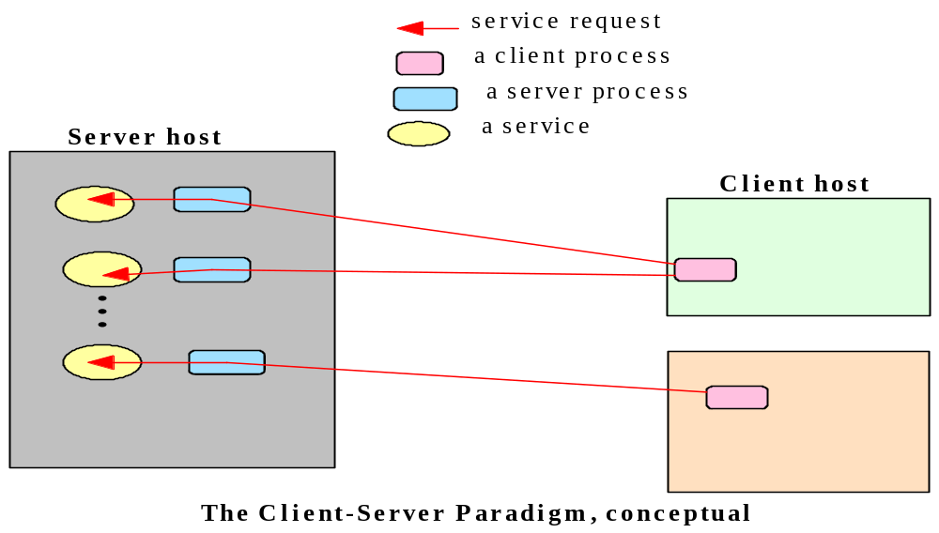
The Client-Server Paradigm
A server process, running on a server host, provides access to a service.
A client process, running on a client host, accesses the service via the server process.
The interaction of the process proceeds according to a protocol.

Slide 4
Client-server applications and services
An application based on the client-server paradigm is a client-server application.
On the Internet, many services are Client-server applications. These services are often known by the protocol that the application implements.
Well known Internet services include HTTP, FTP, DNS, etc.
User applications may also be built using the client-server paradigm.

Slide 5
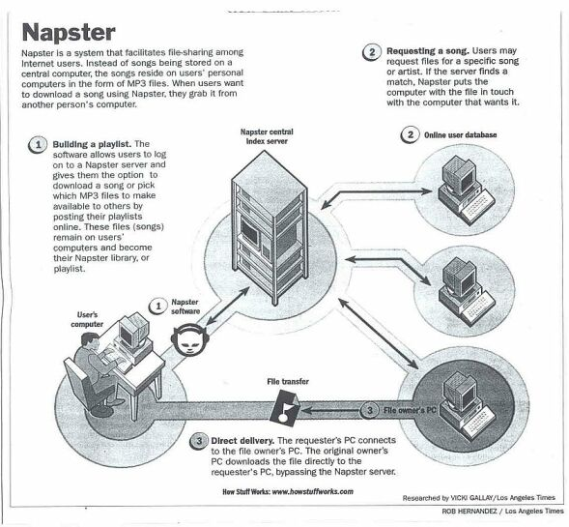
A Sample Client-Server Application

Slide 6
Client-Server
in a client-server system architecture, the terms clients and servers refer to computers (e.g., relational database management system--DBMS) (http://www.sei.cmu.edu/str/descriptions/clientserver_body.html)
in a client-server distributed computing paradigm, the terms clients and servers refer to processes.

Slide 7
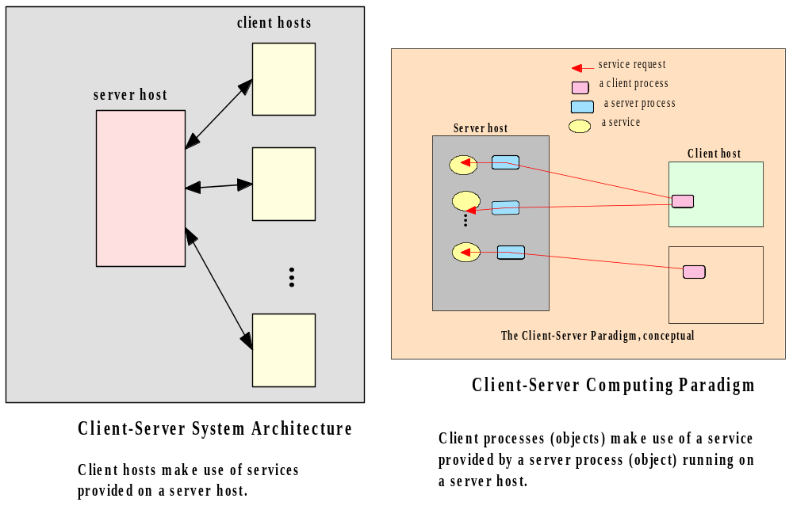
Client-Server: an overloaded term

Slide 8
Systems vs. Processes
<<interface>>
Interface_1
Functions()
<<interface>>
Interface_2
Functions()
Software System
1
composition
realization
*
1
Business Process
*
Business Rule
Data

Slide 9
A Service Session
In the context of the client-server model, we will use the term session to refer to the interaction between the server and one client. (e.g., Interface HttpSession in javax.servlet.http)
The service managed by a server may be accessed by multiple clients who desire the service, sometimes concurrently.
Each client, when being serviced by the server, engages in a separate session with the server, during which it conducts a dialog with the server until the client has obtained the service it required

Slide 10
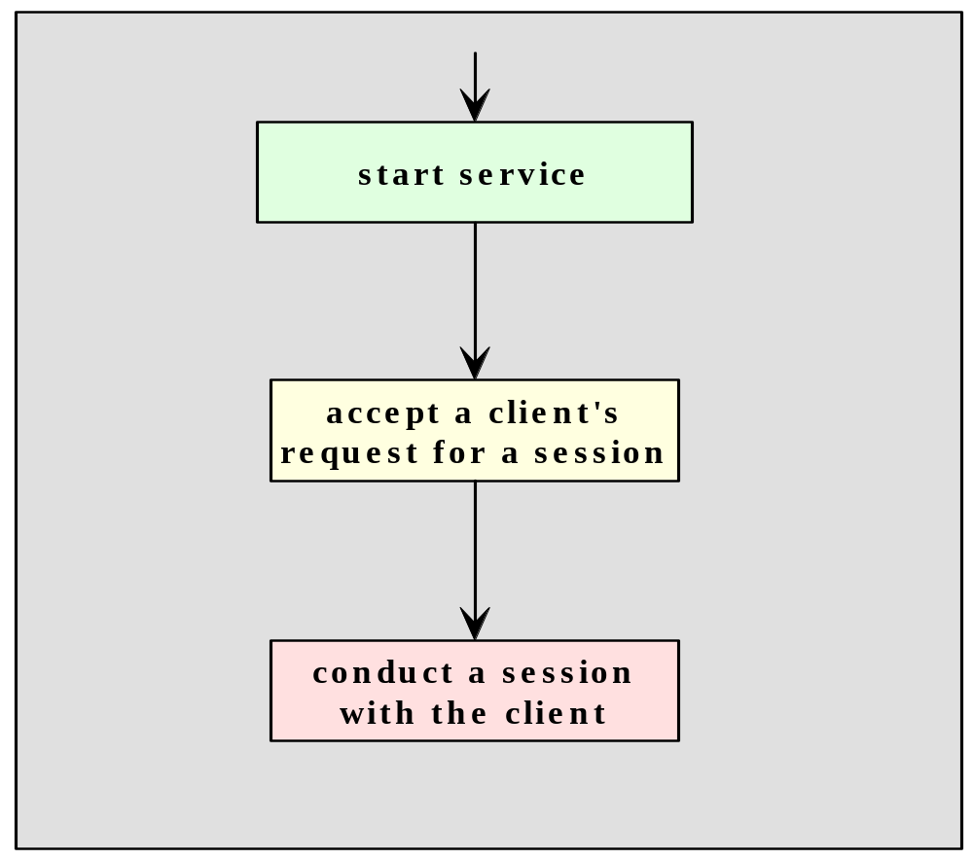
A Service Session
Server Process

Slide 11
The Protocol for a Service
A protocol is needed to specify the rules that must be observed by the client and the server during the conduction of a service session.
Such rules include specifications on matters such as
  how the service is to be located,
  the sequence of interprocess communication
  the representation and interpretation of data exchanged with each IPC.
On the Internet, such protocols are specified in the RFCs (Request For Comments).

Slide 12
Locating A Service
A mechanism must be available to allow a client process to locate a server for a given service.
A service can be located through the address of the server process, in terms of the host name and protocol port number assigned to the server process. This is the scheme for Internet services. Each Internet service is assigned to a specific port number.
A well-known service such as ftp, HTTP, or telnet is assigned a default port number reserved on each Internet host for that service.
At a higher level of abstraction, a service may be identified using a logical name registered with a registry, the logical name will need to be mapped to the physical location of the server process.
If the mapping is performed at runtime (that is, when a client process is run), then it is possible for the service’s location to be dynamic, or moveable.

Slide 13
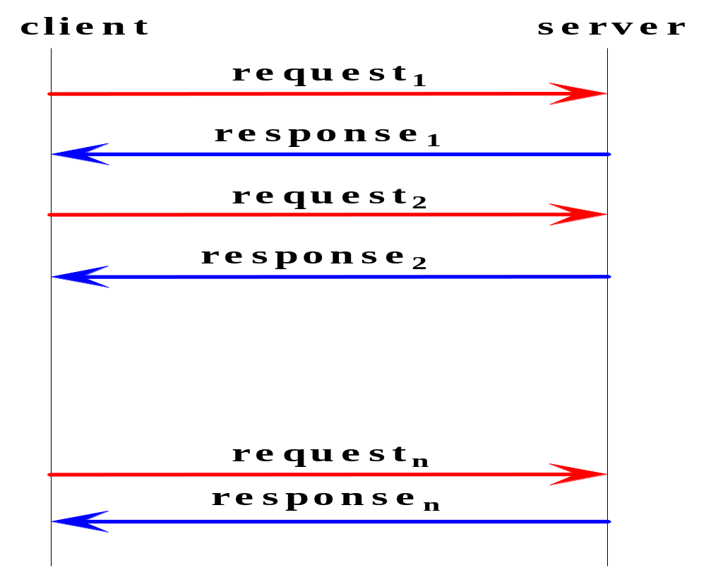
The Interprocess Communications and Event Synchronization
Typically, the interaction of the client and server processes follows a request-response pattern.

Slide 14
Implementation of A Service
Any implementation of the client or server program for this service is expected to adhere to the specification for the protocol, including how the dialogs of each session should proceed.
Among other things, the specification defines
  which side (client or server) should speak first
  the syntax and semantic of each request and response
  the action expected of each side upon receiving a particular request or response.

Slide 15
Session IPC Examples
The dialog in each session follows a pattern prescribed in the protocol specified for the service.
Daytime service [RFC867]:
  Client: Hello, <client address> here. May I have a timestamp please.
  Server: Here it is: (time stamp follows)
World Wide Web session:
  Client: Hello, <client address> here.
  Server: Okay. I am a web server and speaks protocol HTTP1.0.
  Client: Great, please get me the web page index.html at the root of your document tree.
  Server: Okay, here’s what’s in the page: (contents follows).

Slide 16
HTTP Session
1. Telnet to your favorite Web server:
unix> telnet ise.gmu.edu 80
// Open TCP connection to port 80 at ise.gmu.edu.
2. Type in a GET HTTP request:
GET /~yhwang1/ HTTP/1.1
Host: ise.gmu.edu
// Send a minimal GET request to HTTP server (hit carriage return twice)

Slide 17
Client-Server Protocol Data Representation
Part of the specification of a protocol is the syntax and semantics of each request and response.
The choice of data representation depends on the nature and the needs of the protocol.
Representing data using text (character strings) is common, as it facilitates data marshalling and allows the data to be readable by human.
Most well known Internet protocols are client-server, request-response, and text-base.

Slide 18
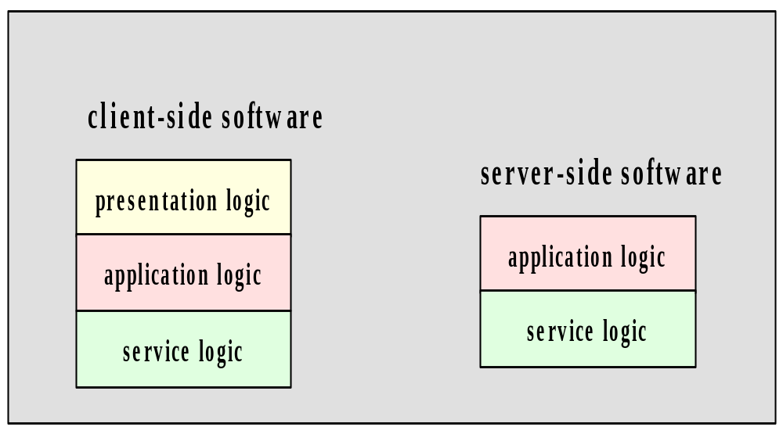
Software Engineering for a Service

Slide 19
Daytime Client-server using Connectionless Datagram Socket - 1
Client-side presentation logic
DaytimeClient1.java encapsulates the client-side presentation logic; that is, it provides the interface for a user of the client process by:
  obtaining input (the server address) from the user
  displaying the output (the timestamp) to the user.
To obtain the timestamp, a method call to a “helper” class, DaytimeClientHelper1.java, is issued. This method hides the details of the application logic and the underlying service logic. In particular, the programmer of DaytimeClient1.java need not be aware of which socket types is used for the IPC.

Slide 20
Daytime Client-server using Connectionless Datagram Socket - 2
Client-side Application logic
The DaytimeClientHelper1.java class encapsulates the client-side application logic. This module performs the IPC for
  sending a request
  receiving a response, using a specialized class of the DatagramSocket, myClientDatagramSocket. data.
  the details of using datagram sockets are hidden from this module. In particular, this module does not need to deal with the byte array for carrying the timestamp
Client-side Service logic
The MyClientDatagram.java class provides the details of the IPC service, in this case using the datagram socket API.

Slide 21
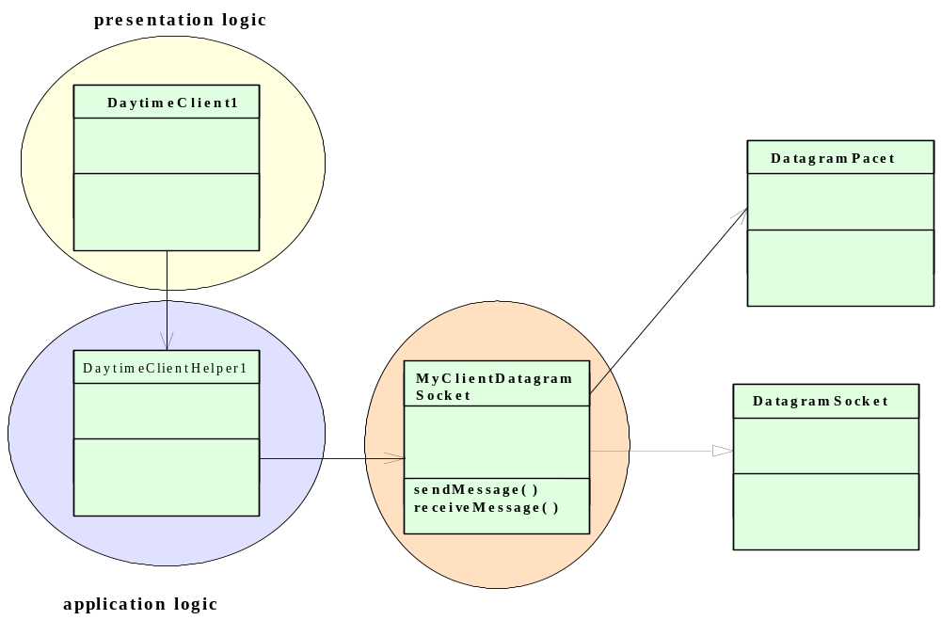
UML Diagram for the Datagram Daytime Client
User input
Output display
Service

Slide 22
Advantages of Separating the Layers of Logic
It allows each module to be developed by people with special skills to focus on a module for which they have expertise. Software engineers who are skilled in user interface may concentrate on developing the modules for the presentation logic, while those specializing in application logic and the service logic may focus on developing the other modules.
The separation allows modifications to be made to the logic at the presentation without requiring changes to be made at the lower layers.
For example, the user interface can be changed from text-mode to graphical without requiring any change be made to the application logic or the service logic.
Likewise, changes made in the application logic should be transparent to the presentation layer, as we will soon illustrate with an example client-server application.

Slide 23
Client Code
public class DaytimeClient1 { // presentation layer
public static void main(String[] args) {
InputStreamReader is = new InputStreamReader(System.in);
BufferedReader br = new BufferedReader(is);
try {
System.out.println("What is the name of the server host?");
String hostName = br.readLine();
if (hostName.length() == 0) // if user did not enter a name
hostName = "localhost"; // use the default host name
System.out.println("What is the port number of the server host?");
String portNum = br.readLine();
if (portNum.length() == 0)
portNum = "13"; // default port number
System.out.println("timestamp received from the server" + DaytimeClientHelper1.getTimestamp(hostName, portNum));
} // end try
catch (Exception ex) { ex.printStackTrace( ); } // end catch
} //end main
} // end class

Slide 24
Client Code
public class DaytimeClientHelper1 { // Application logic layer
public static String getTimestamp(String hostName, String portNum){
String timestamp = "";
try {
InetAddress serverHost = InetAddress.getByName(hostName);
int serverPort = Integer.parseInt(portNum);
// instantiates a datagram socket for both sending and receiving data
MyClientDatagramSocket mySocket = new MyClientDatagramSocket();
mySocket.sendMessage( serverHost, serverPort, ""); // empty message
// now receive the timestamp
timestamp = mySocket.receiveMessage();
mySocket.close( );
} // end try
catch (Exception ex) {
System.out.println("There is a problem: " + ex); }
return timestamp;
} //end getTimeStamp
} //end class

Slide 25
Client Code
public class MyClientDatagramSocket extends DatagramSocket {
static final int MAX_LEN = 100; // Application Service layer
MyDatagramSocket( ) throws SocketException{
super( ); }
MyDatagramSocket(int portNo) throws SocketException{
super(portNo); }
public void sendMessage(InetAddress receiverHost, int receiverPort, String message)
throws IOException {
byte[ ] sendBuffer = message.getBytes( );
DatagramPacket datagram =
new DatagramPacket(sendBuffer, sendBuffer.length, receiverHost, receiverPort);
this.send(datagram);
} // end sendMessage
public String receiveMessage() throws IOException {
byte[ ] receiveBuffer = new byte[MAX_LEN];
DatagramPacket datagram = new DatagramPacket(receiveBuffer, MAX_LEN);
this.receive(datagram);
String message = new String(receiveBuffer);
return message;
} //end receiveMessage
} //end class

Slide 26
Server-side software
Presentation logic
Typically, there is very little presentation logic on the server-side. In this case, the only user input is for the server port, which, for simplicity, is handled using a command-line argument.

Slide 27
Server-side software
Application logic
The DaytimeServer1.java class encapsulates the server-side application logic. This module executes in a forever loop,
  waiting for a request from a client and then conduct a service session for that client.
  sending a response, using a specialized class of the DatagramSocket, myServerDatagramSocket.
  the details of using datagram sockets are hidden from this module. In particular, this module does not need to deal with the byte array for carrying the payload data.
Service logic
The MyServerDatagram.java class provides the details of the IPC service, in this case using the datagram socket API.

Slide 28
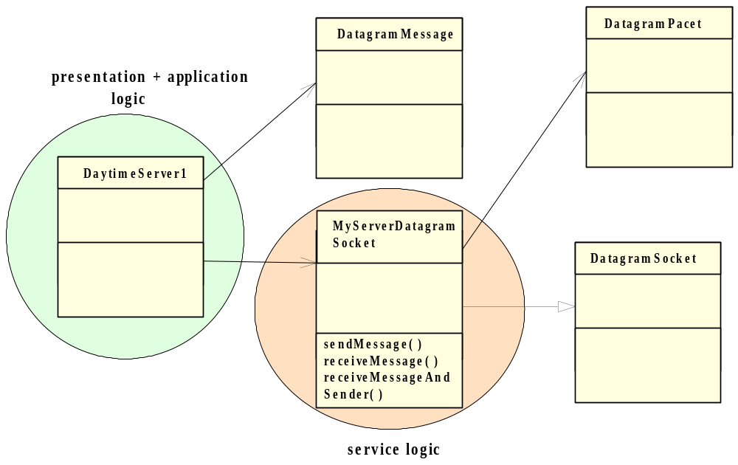
UML Diagram for the Datagram Daytime server

Slide 29
Server Code
public class DaytimeServer1 {// Presentation and Application logic layer
public static void main(String[] args) {
int serverPort = 13; // default port
if (args.length == 1 ) serverPort = Integer.parseInt(args[0]);
try { // instantiates a datagram socket for both sending and receiving data
MyServerDatagramSocket mySocket = new MyServerDatagramSocket(serverPort);
System.out.println("Daytime server ready.");
while (true) { // forever loop
DatagramMessage request = mySocket.receiveMessageAndSender();
System.out.println("Request received");
// The message received is not important; sender's address is what we need to reply
// obtain the timestamp from the local system.
Date timestamp = new Date ();
System.out.println("timestamp sent: "+ timestamp.toString());
// Now send the reply to the requestor
mySocket.sendMessage(request.getAddress( ), request.getPort( ), timestamp.toString( ));
} //end while
} // end try
catch (Exception ex) { System.out.println("There is a problem: " + ex); } // end catch
} //end main
} // end class

Slide 30
Server Code
public class MyServerDatagramSocket extends DatagramSocket {
static final int MAX_LEN = 100; // Application Service layer
MyServerDatagramSocket(int portNo) throws SocketException{ super(portNo); }
public void sendMessage(InetAddress receiverHost, int receiverPort, String message)
throws IOException {
byte[ ] sendBuffer = message.getBytes( );
DatagramPacket datagram = new DatagramPacket(sendBuffer, sendBuffer.length,
receiverHost, receiverPort);
this.send(datagram); } // end sendMessage
public DatagramMessage receiveMessageAndSender( ) throws IOException {
byte[ ] receiveBuffer = new byte[MAX_LEN];
DatagramPacket datagram = new DatagramPacket(receiveBuffer, MAX_LEN);
this.receive(datagram);
// create a DatagramMessage object, to contain message received and sender's address
DatagramMessage returnVal = new DatagramMessage( );
returnVal.putVal(new String(receiveBuffer), datagram.getAddress( ), datagram.getPort( ));
return returnVal; } //end receiveMessage
} //end class

Slide 31
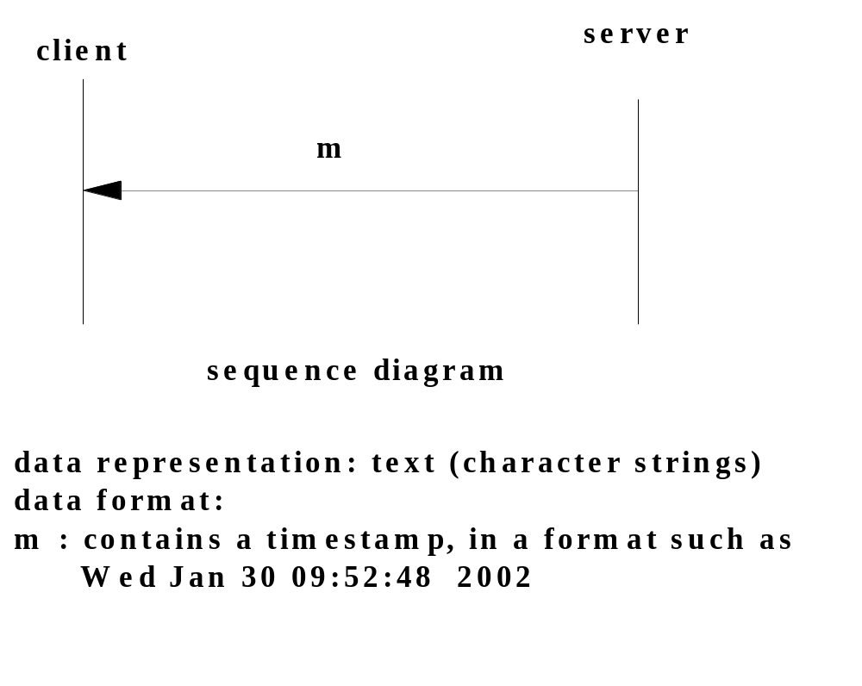
Example protocol: daytime
Defined in RFC867

Slide 32
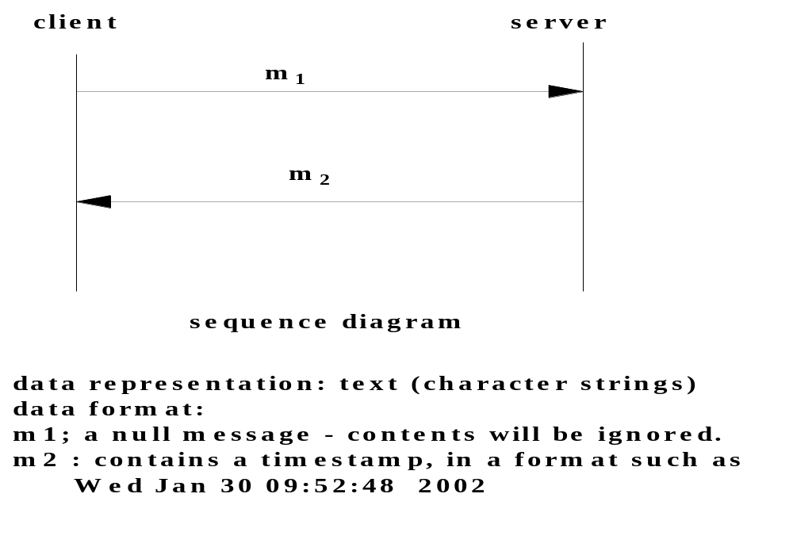
Daytime Protocol

Slide 33
Daytime Protocol Implementation
Sample 1 – using connectionless sockets:
DaytimeServer1.java
DaytimeClient1.java
(http://ise.gmu.edu/~yhwang1/SWE622/Sample_Codes/chapter5)

Slide 34
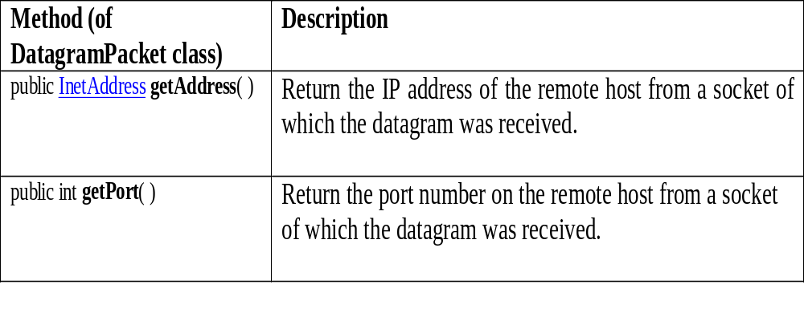
The getAddress and getPort Methods

Slide 35
Daytime Protocol Implementation
Connection-oriented Daytime Server Client:
Sample 2 – using connection-oriented sockets:
DaytimeServer2.java
DaytimeClient2.java
DaytimeClientHelper2.java
MyStreamSocket.java
(http://ise.gmu.edu/~yhwang1/SWE622/Sample_Codes/chapter5)

Slide 36
Server Code
public class DaytimeServer2 {// presentation and Application layer
public static void main(String[] args) {
int serverPort = 13; // default port
if (args.length == 1 ) serverPort = Integer.parseInt(args[0]);
try { // instantiates a stream socket for accepting connections
ServerSocket myConnectionSocket = new ServerSocket(serverPort);
System.out.println("Daytime server ready.");
while (true) { // forever loop, wait for a connection
/**/ System.out.println("Waiting for a connection.");
MyStreamSocket myDataSocket = new MyStreamSocket(myConnectionSocket.accept( ));
// Note: there is no need to read a request - the request is implicit.
/**/ System.out.println("A client has made connection.");
Date timestamp = new Date ();
/**/ System.out.println("timestamp sent: "+ timestamp.toString());
// Now send the reply to the requestor
myDataSocket.sendMessage(timestamp.toString( ));
myDataSocket.close( ); } //end while
} // end try
catch (Exception ex) { ex.printStackTrace( ); } // end catch
} //end main
} // end class

Slide 37
Server Code
public class MyStreamSocket extends Socket {// Application Service layer
private Socket socket; private BufferedReader input; private PrintWriter output;
MyStreamSocket(InetAddress acceptorHost, int acceptorPort ) throws SocketException,
IOException{ socket = new Socket(acceptorHost, acceptorPort ); setStreams( ); }
MyStreamSocket(Socket socket) throws IOException { this.socket = socket; setStreams( ); }
private void setStreams( ) throws IOException{// an input stream for reading data
InputStream inStream = socket.getInputStream();
input = new BufferedReader(new InputStreamReader(inStream));
OutputStream outStream = socket.getOutputStream();
output = new PrintWriter(new OutputStreamWriter(outStream)); }
public void sendMessage(String message) throws IOException {
output.println(message);
output.flush(); } // end sendMessage
public String receiveMessage( ) throws IOException { // read a line from the data stream
String message = input.readLine( );
return message; } //end receiveMessage
} //end class

Slide 38
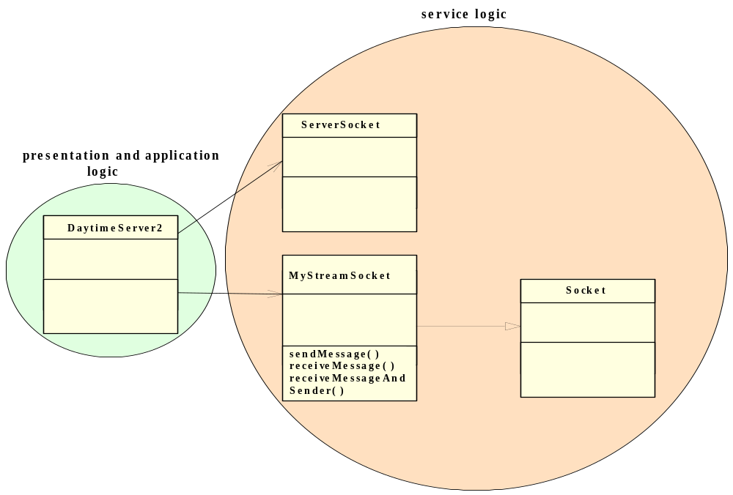
UML Diagram for stream mode Daytime Server

Slide 39
Client Code
public class DaytimeClient2 { // Presentation Layer
public static void main(String[] args) {
InputStreamReader is = new InputStreamReader(System.in);
BufferedReader br = new BufferedReader(is);
try {
System.out.println("What is the name of the server host?");
String hostName = br.readLine();
if (hostName.length() == 0) // if user did not enter a name
hostName = "localhost"; // use the default host name
System.out.println("What is the port number of the server host?");
String portNum = br.readLine();
if (portNum.length() == 0) portNum = "13"; // default port number
System.out.println("Here is the timestamp received from the server"
+ DaytimeClientHelper2.getTimestamp(hostName, portNum));
} // end try
catch (Exception ex) { ex.printStackTrace( ); } // end catch
} //end main
} // end class

Slide 40
Client Code
public class DaytimeClientHelper2 {// Application Logic Layer
public static String getTimestamp(String hostName,
String portNum) throws Exception {
String timestamp = "";
InetAddress serverHost = InetAddress.getByName(hostName);
int serverPort = Integer.parseInt(portNum);
/**/ System.out.println("Connection request made");
MyStreamSocket mySocket = new MyStreamSocket(serverHost, serverPort);
// now wait to receive the timestamp
timestamp = mySocket.receiveMessage();
mySocket.close( ); // disconnect is implied
return timestamp;
} //end
} //end class

Slide 41
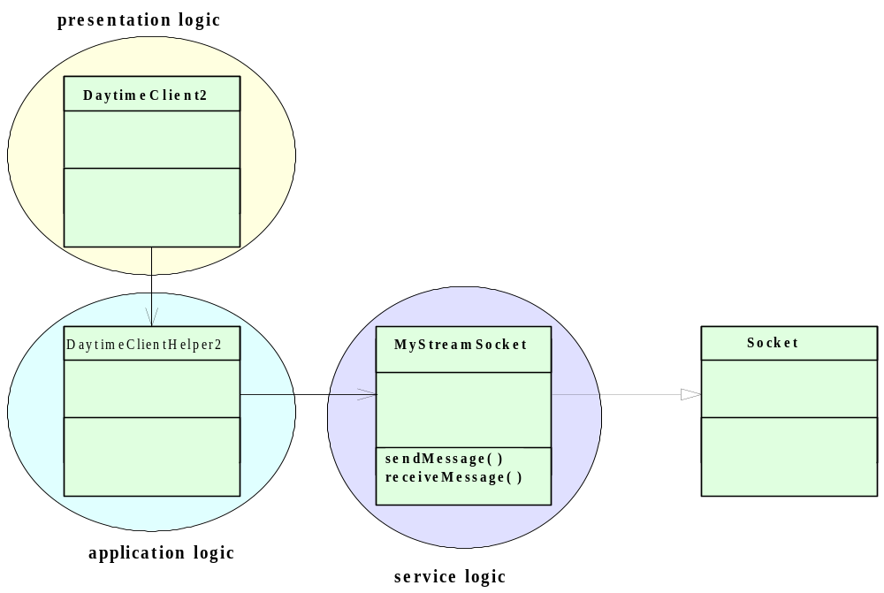
UML Diagram for Stream mode Daytime Client

Slide 42
Testing a Service
Because of its inherent complexity, network software is notoriously difficult to test.
Use the three-layered software architecture and modularize each layer on both the client and the server sides.
Use an incremental or stepwise approach in developing each module. Starting with stubs for each method, compile and test a module each time after you put in additional details.
Develop the client first. It is sometimes useful to employ an Echo server (to be introduced in the next section) which is known to be correct and which uses a compatible IPC mechanism to test the client independent of the server; doing so allows you to develop the client independent of the server.
Use diagnostic messages throughout each program to report the progress of the program during runtime.
Test the client-server suite on one machine before running the programs on separate machine.

